Slide 1


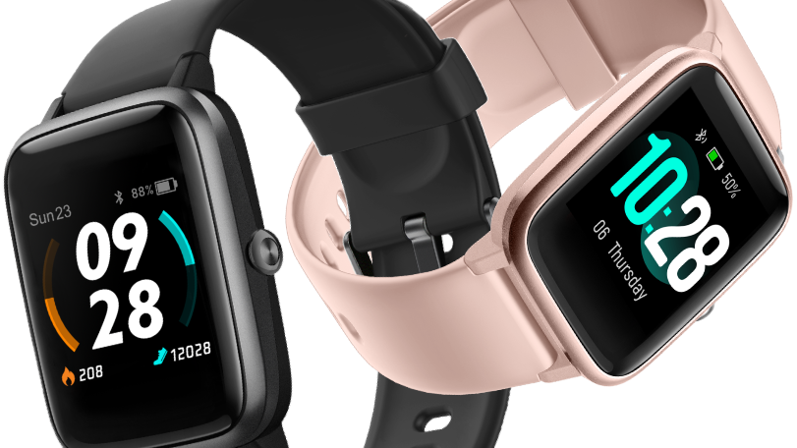
The smart watch situation in today’s world
Made by: karácsony zoltán

Slide 2
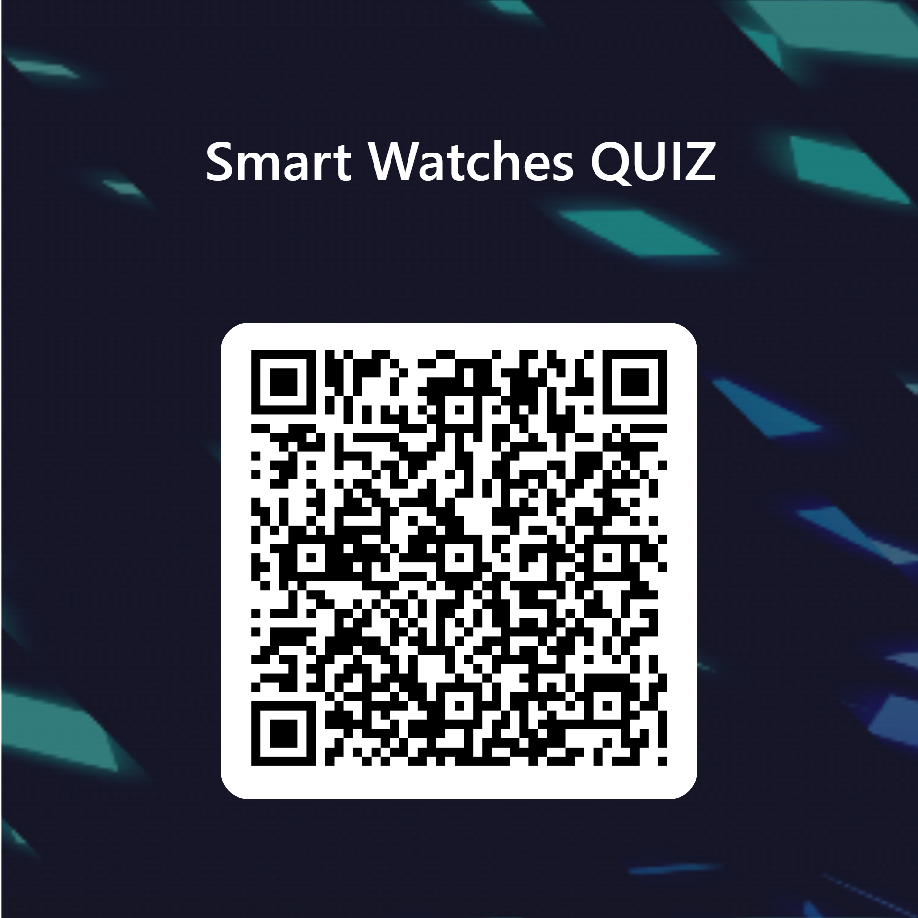
But before we start, a quick quiz about smart watches

Slide 3
What are smart watches?
And the uses of them

Slide 4
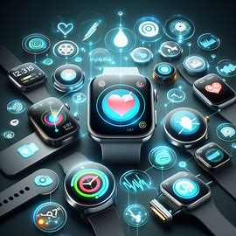
Smartwatches are wearable devices that do many things like show notifications, track fitness, monitor health, and control other devices.

Slide 5
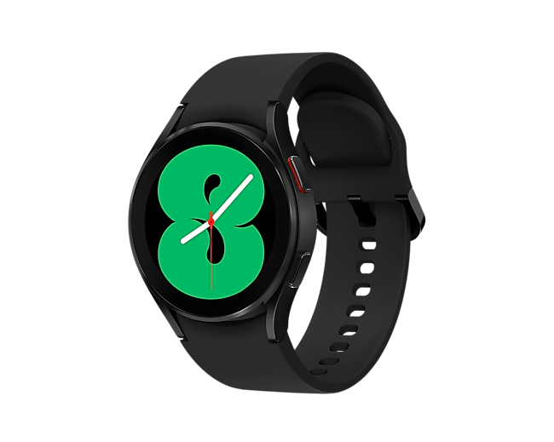
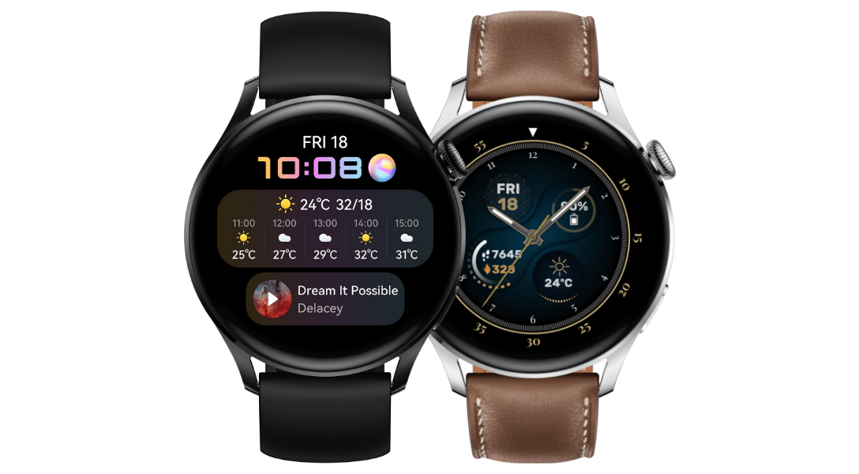
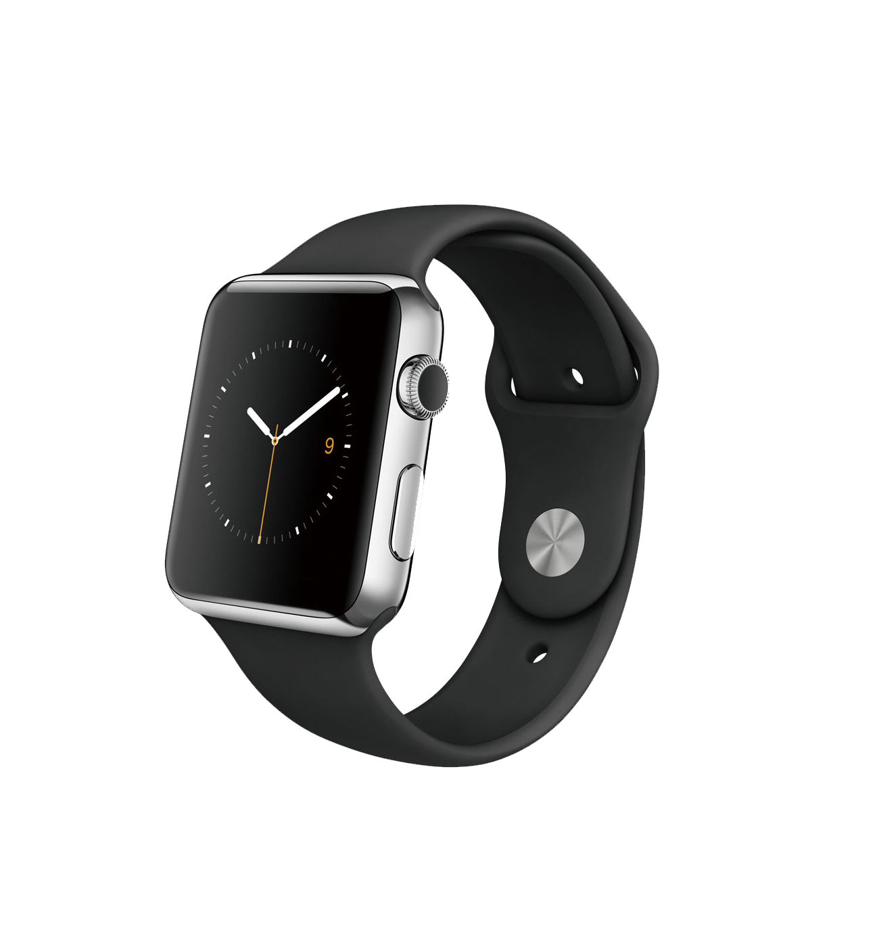
There are different kinds of smartwatches that vary in shape, size, style, and operating system. Some work with smartphones and some work by themselves.

Slide 6
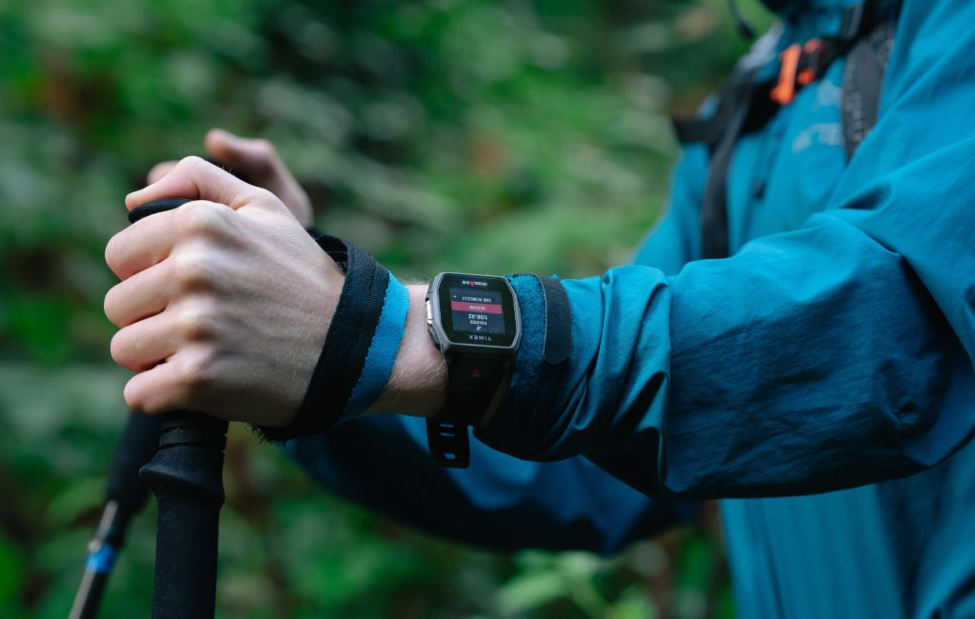
Smartwatches have become more common and better in recent years. They have features like touchscreens, voice assistants, GPS, cellular connectivity, and wireless charging.

Slide 7
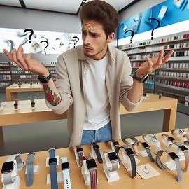
What should you choose?
I will compare 3 watches and tell you what you need to look out for.

Slide 8
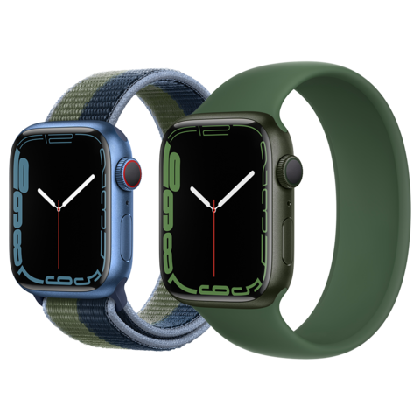
Apple watch series 7
Has a larger and more durable display than previous models
Supports fast charging and longer battery life
Features blood oxygen, ECG, and heart rate sensors
Compatible with iOS devices and various fitness apps
Comes in different sizes, colors, and bands

Slide 9
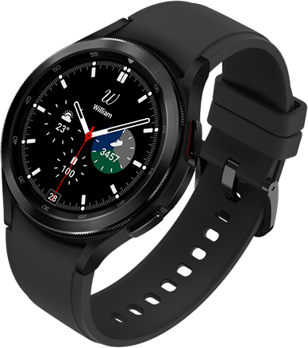
Samsung Galaxy Watch 4
Runs on the new Wear OS platform co-developed with Google
Offers advanced health and wellness tracking features
Supports wireless charging and offline Spotify playback
Compatible with Android devices and Google services
Comes in different styles, sizes, and materials

Slide 10
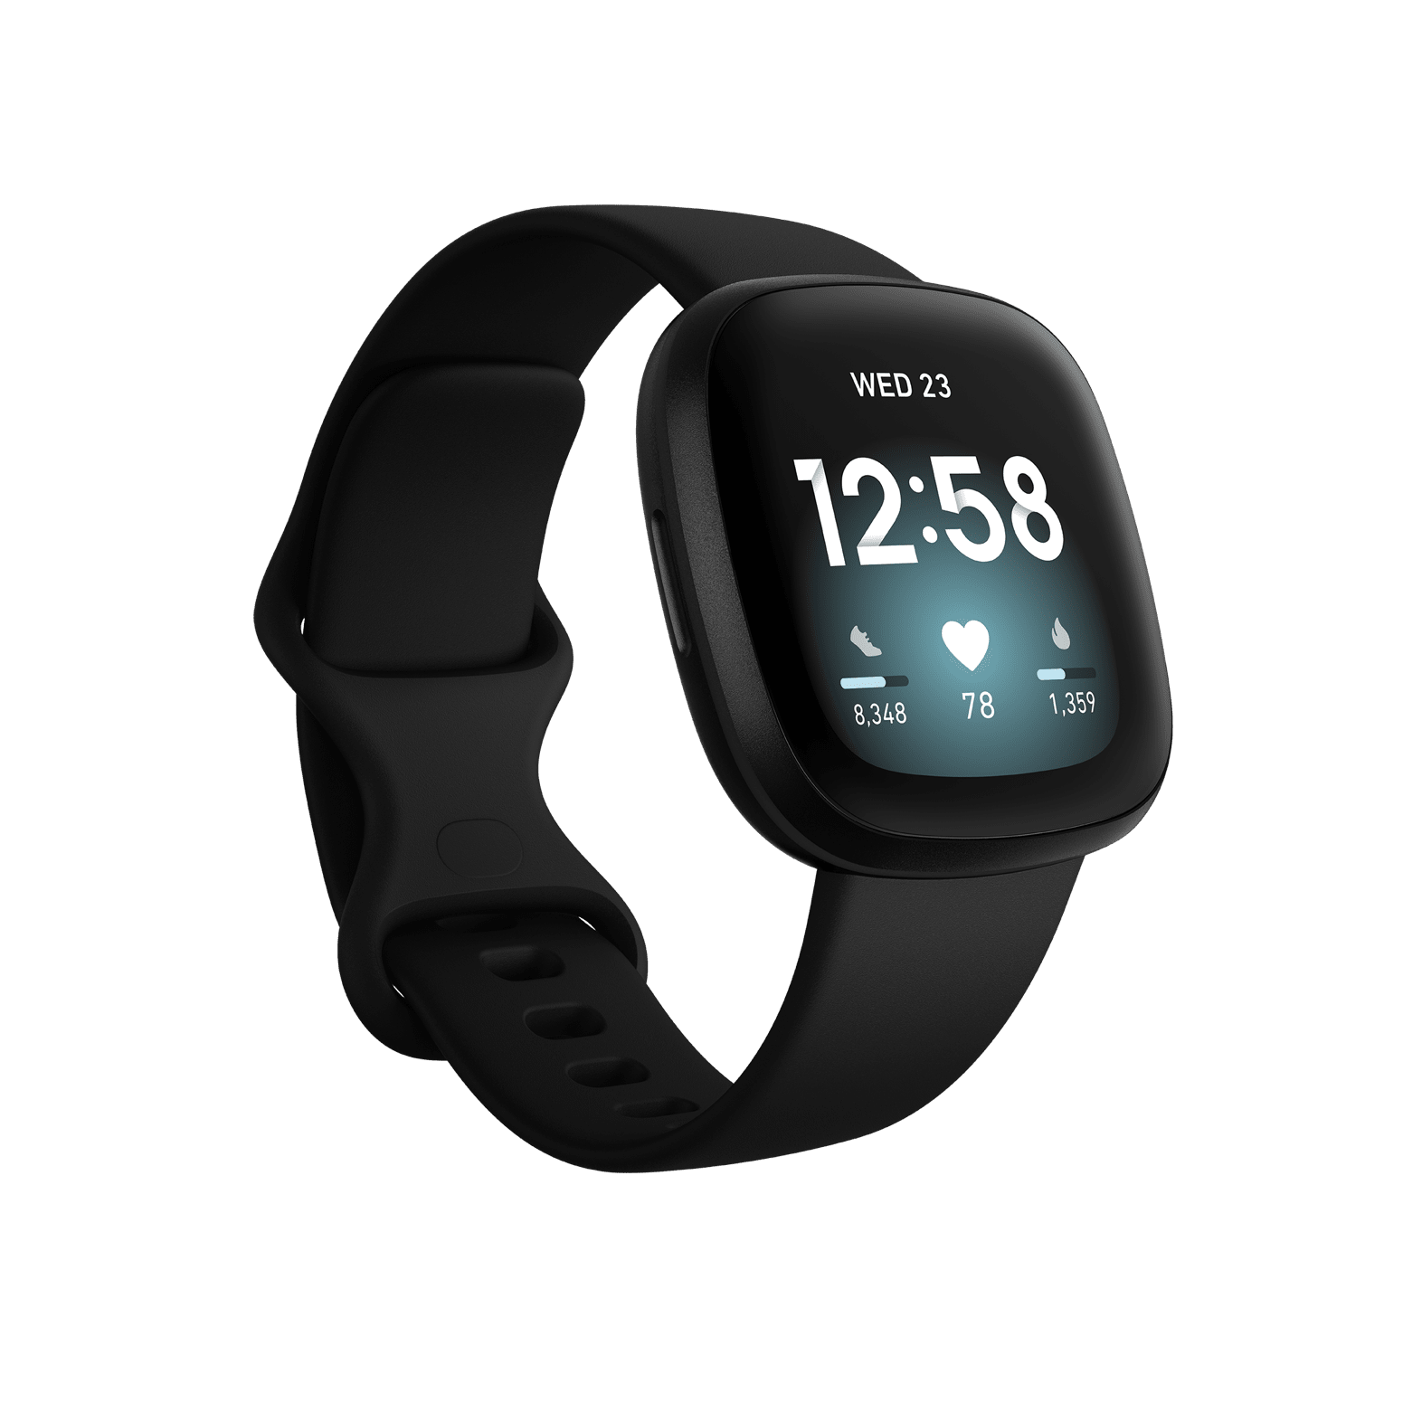
Fitbit Versa 3
Has a sleek and lightweight design with an AMOLED display
Tracks various activities, sleep stages, and SpO2 levels
Supports voice assistants, calls, and notifications
Compatible with both iOS and Android devices
Comes with a six-month free trial of Fitbit Premium

Slide 11
Thanks for watching!
Have a nice day!

